Slide 1

Cloud Computing Presentation

Slide 2

Background/Context
In the world of academia, the start of a new semester often brings with it a wave of stress and uncertainty
To help alleviate such stress, our web application aims to provide a platform where students can find study guides for their selected courses, uploaded by their fellow students
These guides could include advice on what topics to focus on, potential questions for midterms and finals, personal interpretations of challenging subjects, and resources that have been helpful in understanding various topics

Slide 3
Problem Statement
The problem we are addressing is the lack of a centralized platform for students to access peer-created study guides for specific courses
With our solution, we aim to provide an accessible, easy-to-use, and efficient means for students to find the information they need to succeed in their academic journey

Slide 4
Web Application Summary
Our web application is an application that allows a user to find study guides for a selected course, study guides that have been uploaded by other students for a particular course
The study guides are stored in a database using different AWS S3 buckets , and within the database, the study guides will be contained in a specific S3 bucket base on courses they are intended for
We will use an AWS API Gateway that acts as an intermediary to retrieve and load the study guide on the web app because we don’t want direct access to the Database from the web application

Slide 5

Technical Stack
AWS Amplify : This is your front-end, where users interact with your application
AWS API Gateway: This service is directly linked to your Amplify application
AWS Lambda: Two Lambda functions are present
AWS S3 Buckets: There are multiple S3 buckets, each containing study guides for a specific class

Slide 6

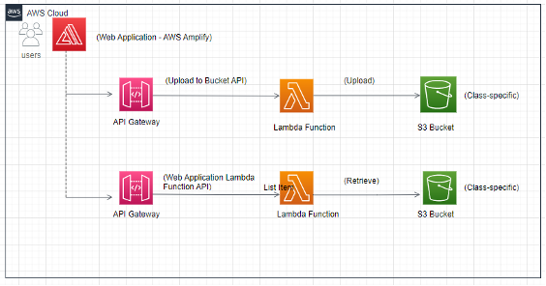
Technical Architecture Diagram
Our application's technical architecture is as follows: User Interface -> AWS Amplify -> AWS API Gateway -> AWS Lambda -> AWS S3

Slide 7

Deliverables
AWS Account Setup and S3 Bucket Creation
AWS Lambda Function Creation
API Gateway Endpoint Creation
Web Application Development and Testing

Slide 8
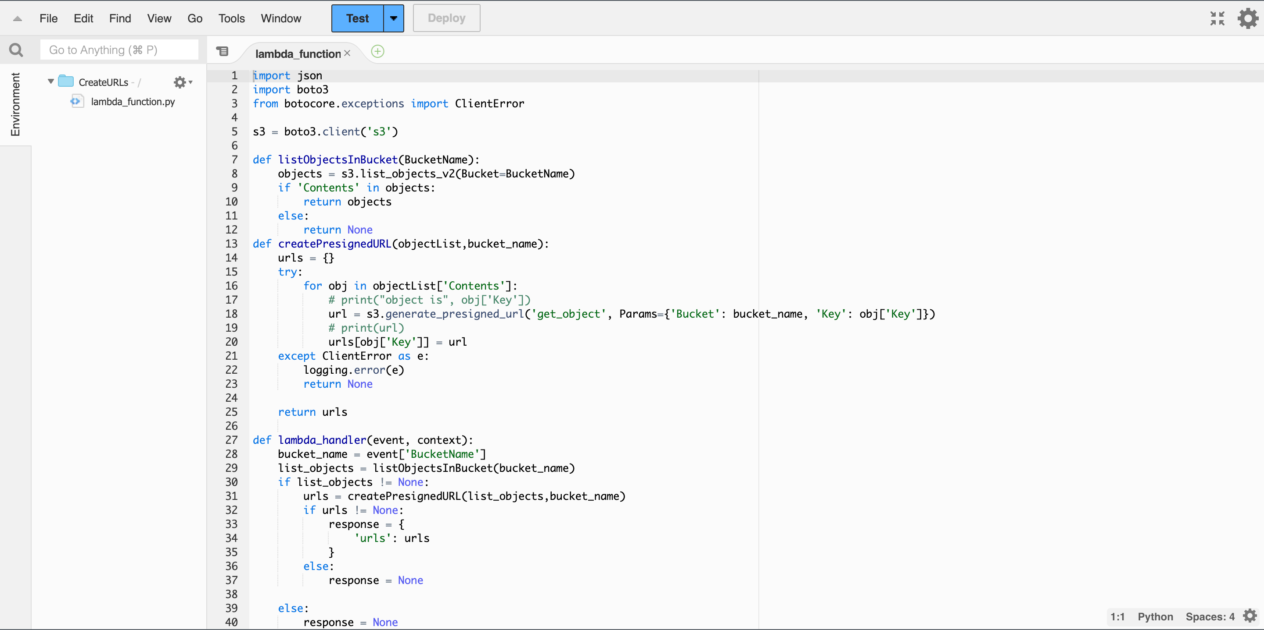
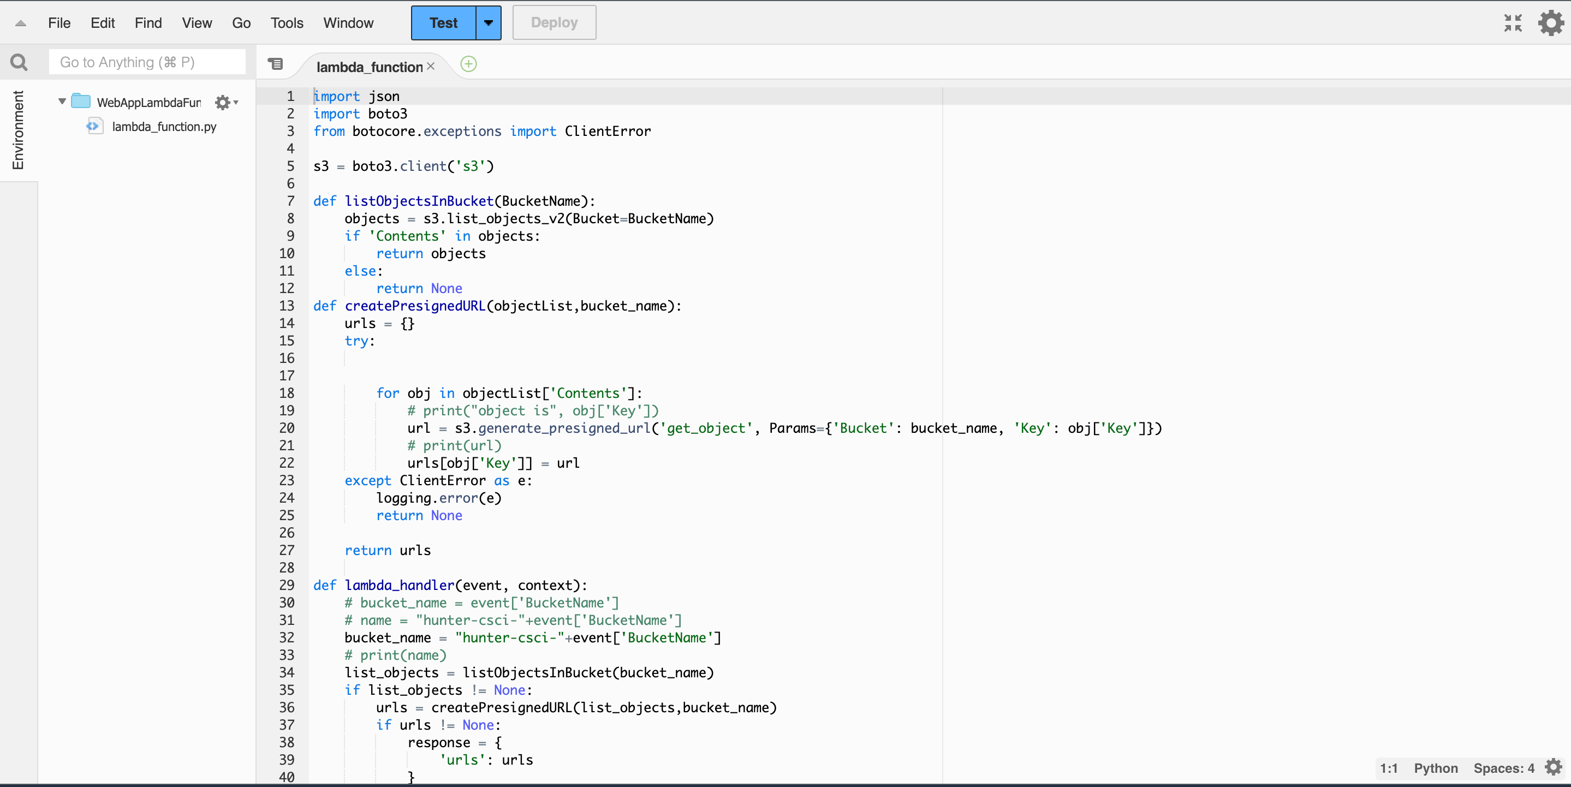
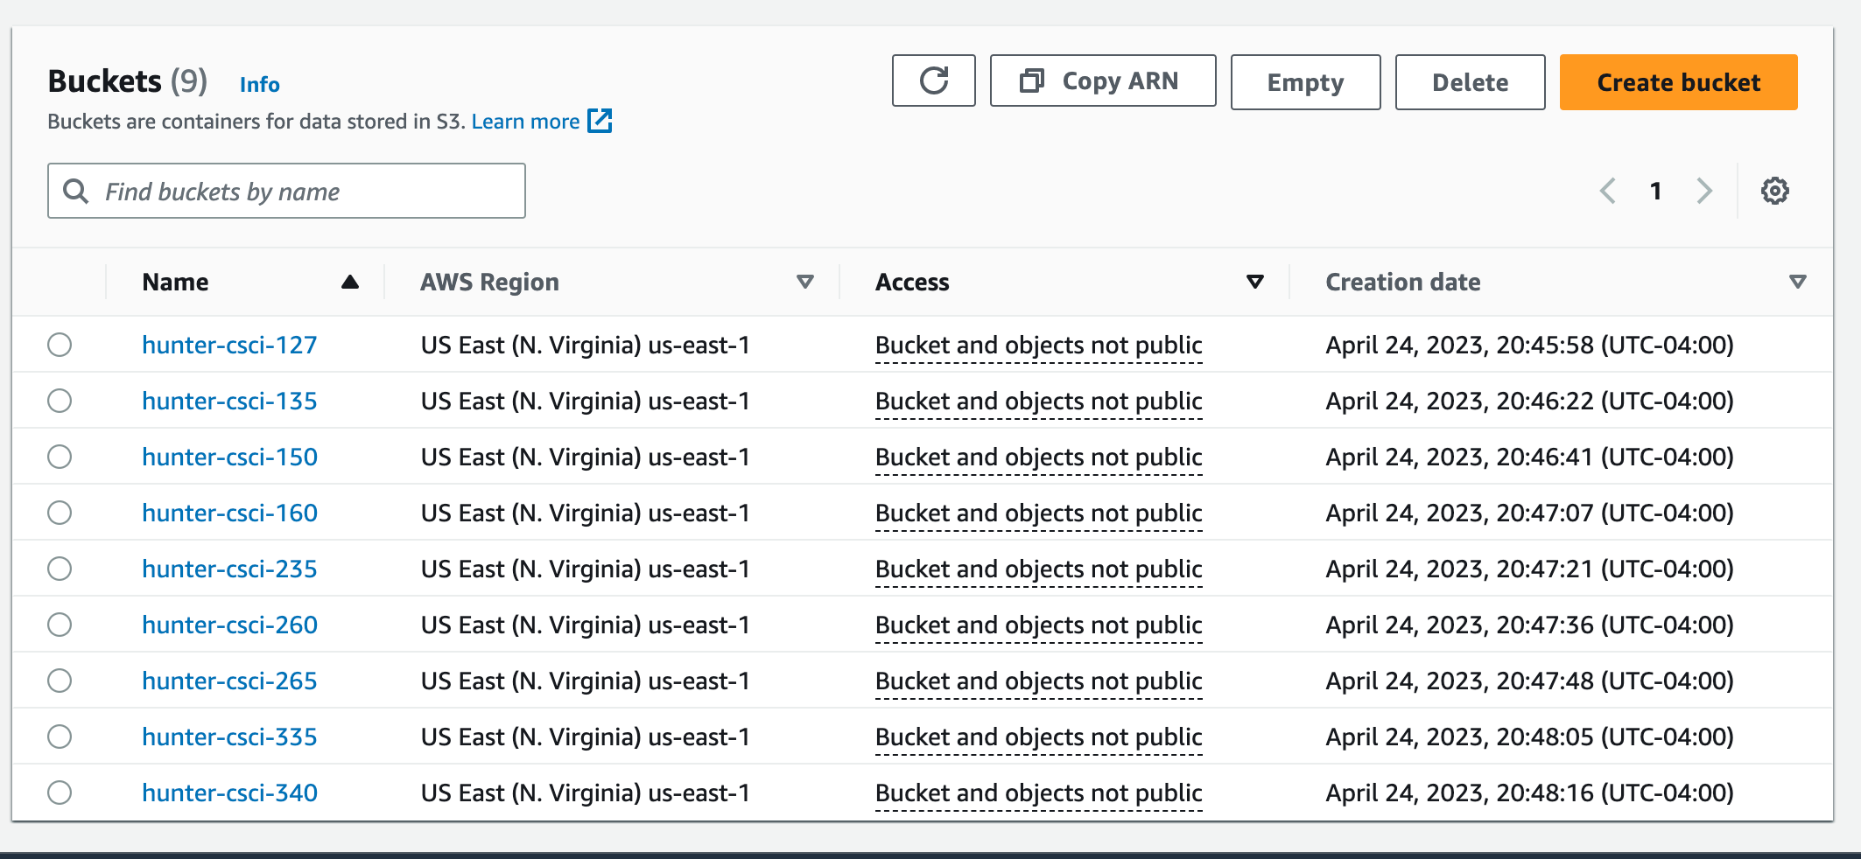
AWS Functionalities

Slide 9
Retrieving objects from a buckets

Slide 10
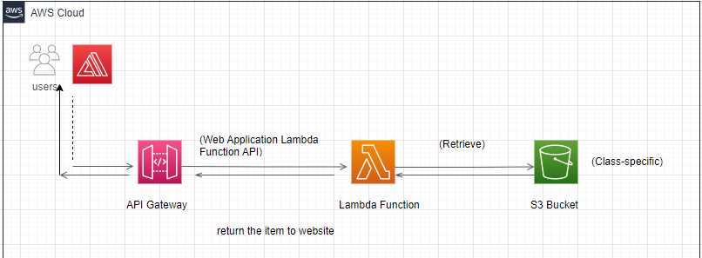

Slide 11
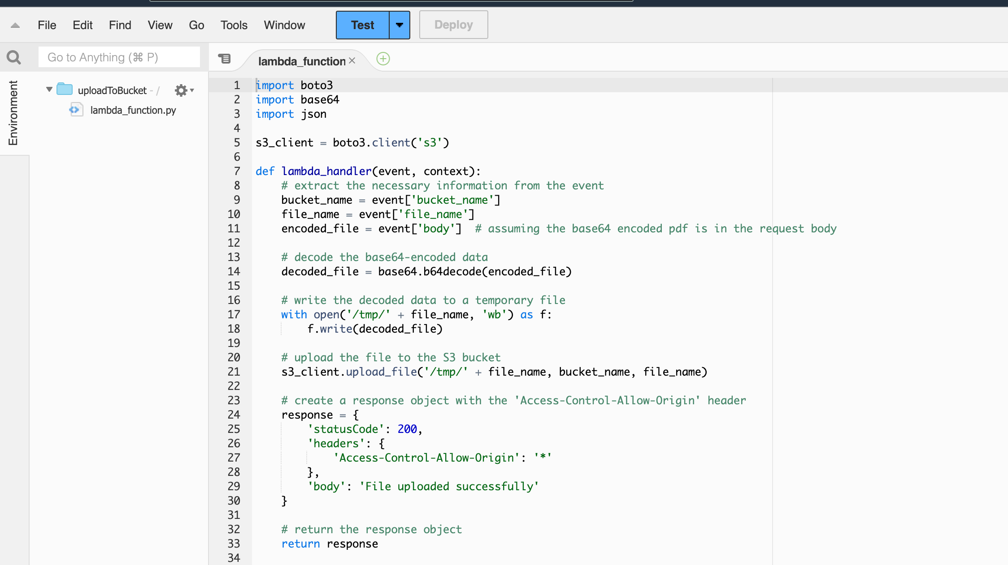
Uploading to a Bucket

Slide 12
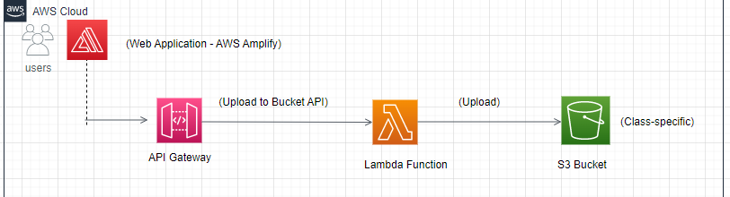

Slide 13

Estimated Cost
The estimated cost for this project, which includes the use of various AWS services and other resources, is as follows based on the assumption that there will be 5000 API calls per month: Upfront cost: $0.00 Monthly cost: $21.55 Total cost for 12 months: $256.80 This cost estimation is subject to change based on the actual usage of AWS services and potential modifications in their pricing

Slide 14

What we would like to expand upon
Intergrade a login feature and allow uploading only to users that is logged in.
Allow for larger files to be uploaded.
Make the web pages look better.
Allow for quick editing and reuploaded of already uploaded files.
Make the User experience nicer

Slide 15

Conclusion
In conclusion, this project aims to provide a robust and easy-to-use platform for students to access and share study guides
The use of AWS services ensures scalability and reliability, allowing the platform to handle a growing number of users and data
With a clear timeline and role distribution, we aim to deliver this project on time and within budget, providing maximum value to our end users - the students

Slide 16

Cloud Computing Web App Project Created By Tahj, Xiuyi, Fahad and Arif

